Slide 1
Open-compartment open model
Determination of pharmacokinetic parameters from urinary excretion data after IV bolus administration
Asisstant lecturer : Aula Jawad

Slide 2
IV bolus administration

Slide 3
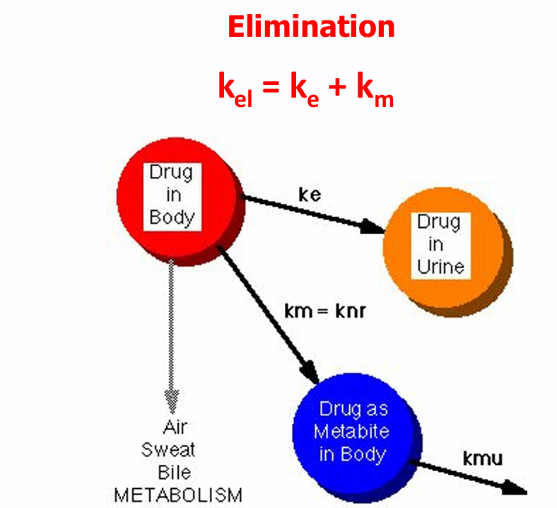

Slide 4
URINARY EXCRETION DATA
Criteria for Obtaining Valid Urinary Excretion Data
A significant amount of drug must be excreted unchanged in the urine (at least 20%)
The analytical method must be specific for the unchanged drug; metabolites should not interfere.
Urine samples must be collected for at least 7 biological half-lives in order to ensure collection of more than 99% of excreted drug
Frequent sampling should be done in order to obtain a good curve.
Changes in urine pH and urine volume may alter the urinary excretion rate
Volunteers must be instructed to completely empty their bladder while collecting urine samples.

Slide 5
Urine Sample
The concentration of drug in urine
Volume of the urine sample

Slide 6
Methods to estimate pharmacokinetic parameters from urinary excretion data.
Rate excretion method and
The ''amount remaining to be excreted'' (ARE) method, also known as the sigma-minus method.

Slide 7
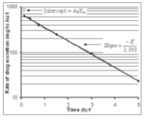
Excretion Rate Method
If the rate of excretion is plotted against the average time (mid point of collection period) (t*), on semilogarithmic paper, the slope will permit the determination of the elimination rate constant (K); and the intercept will represent the initial rate of excretion (KuA0).
Slope = - kT/2.303
Intercept = A^{O} Kr
K total= K renal + K non-renal

Slide 8
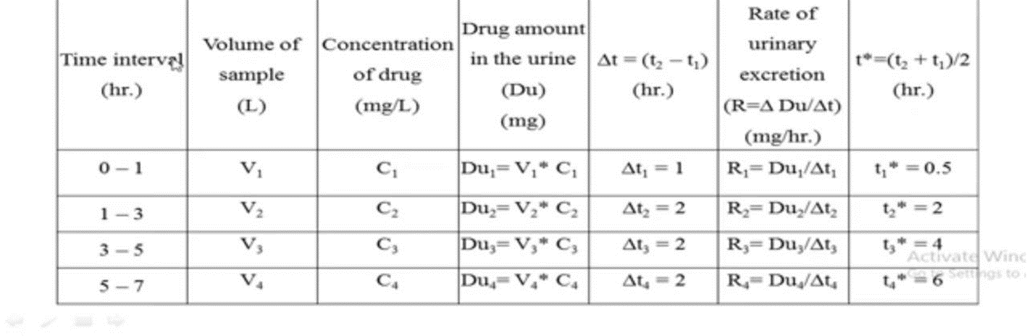
Excretion Rate Method

Slide 9
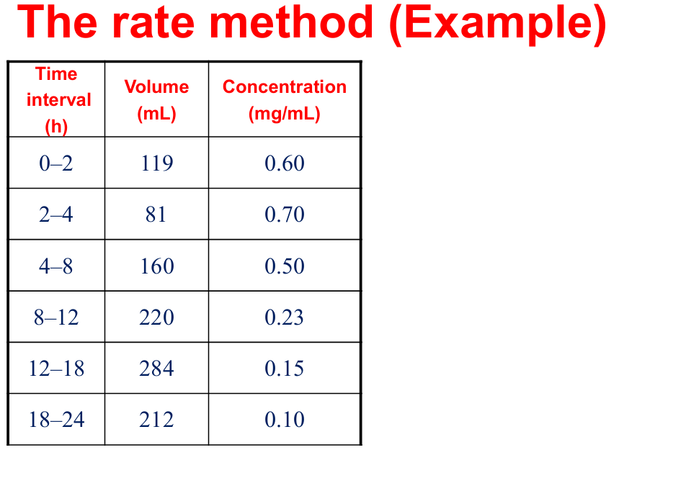

Slide 10
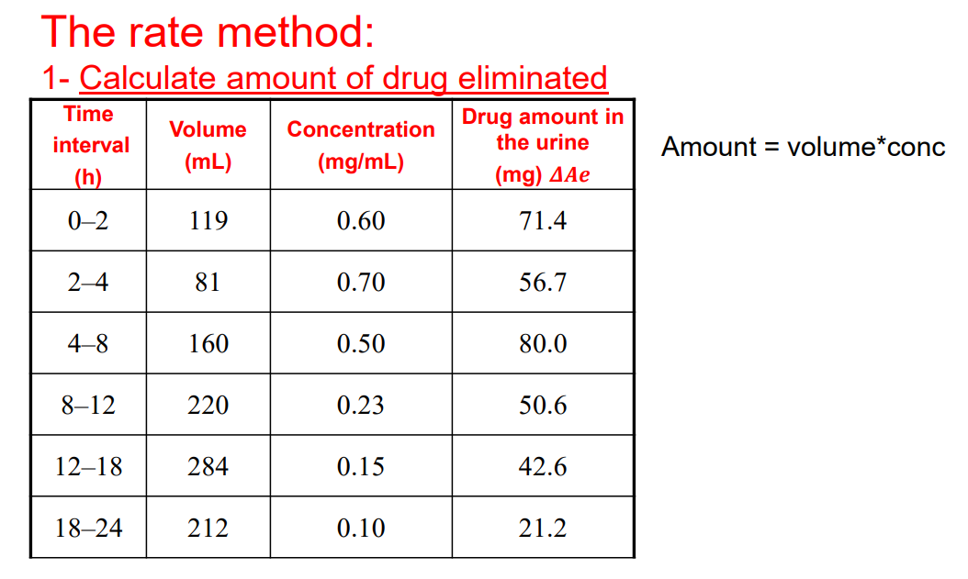

Slide 11
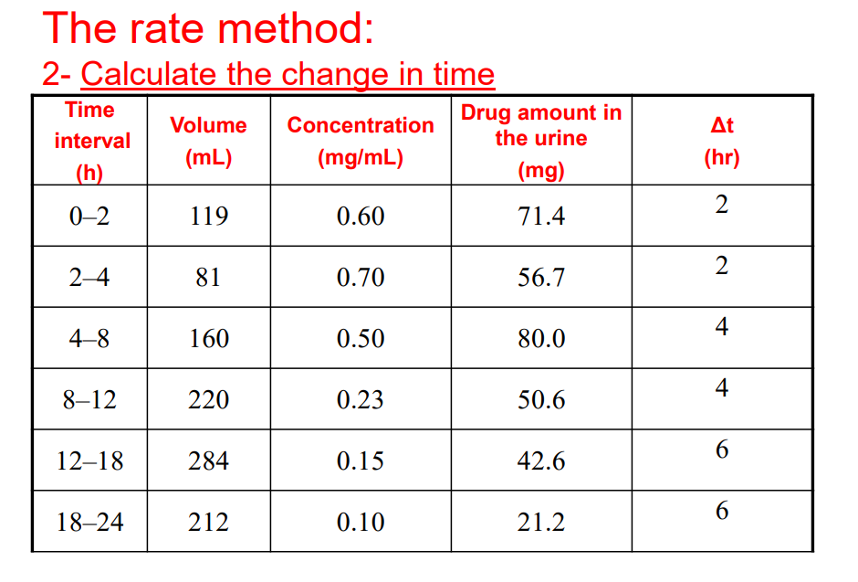

Slide 12
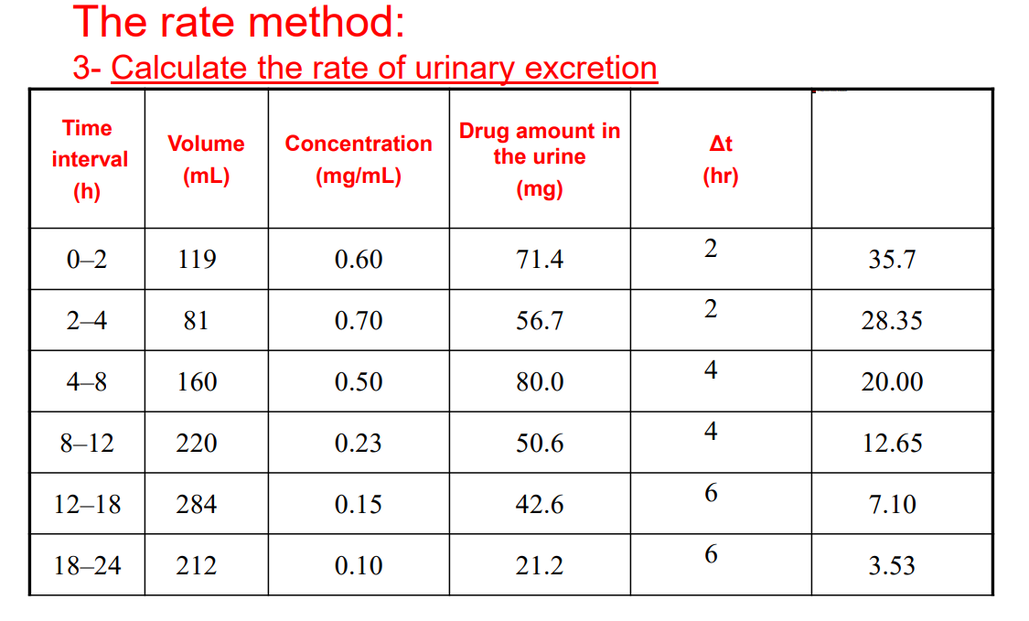

Slide 13
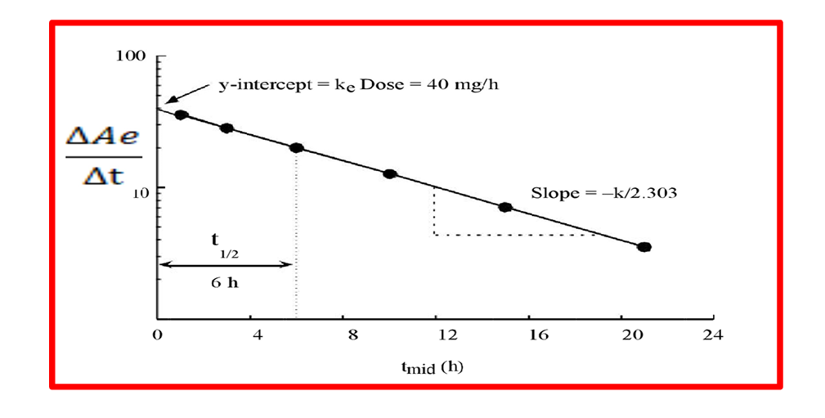
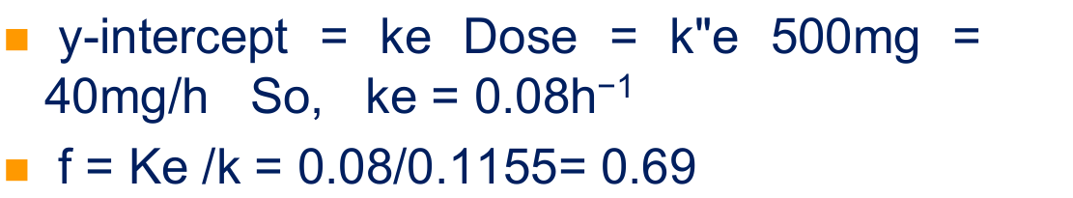

Slide 14
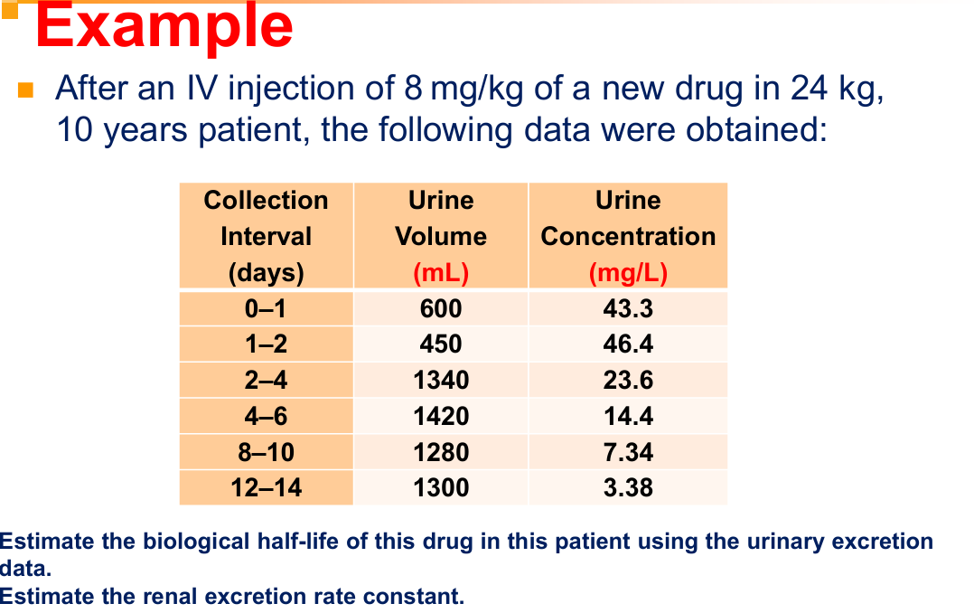

Slide 15
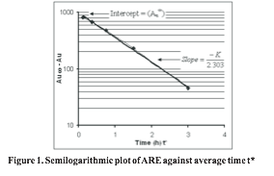
Sigma-minus method/ amount remaining to be excreted (ARE) method
A plot of the amount of drug remaining to be excreted (ARE) against end time (t ) on semilogarithmic co-ordinates gives a straight line.
Slope= -KT/2.303

Slide 16
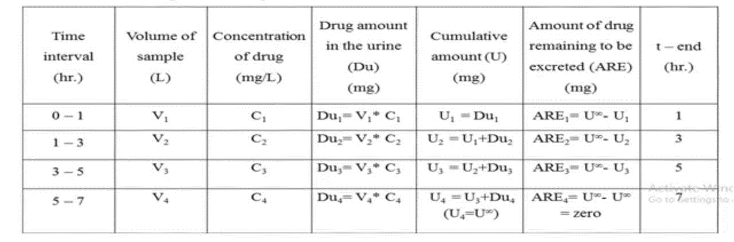

Slide 18
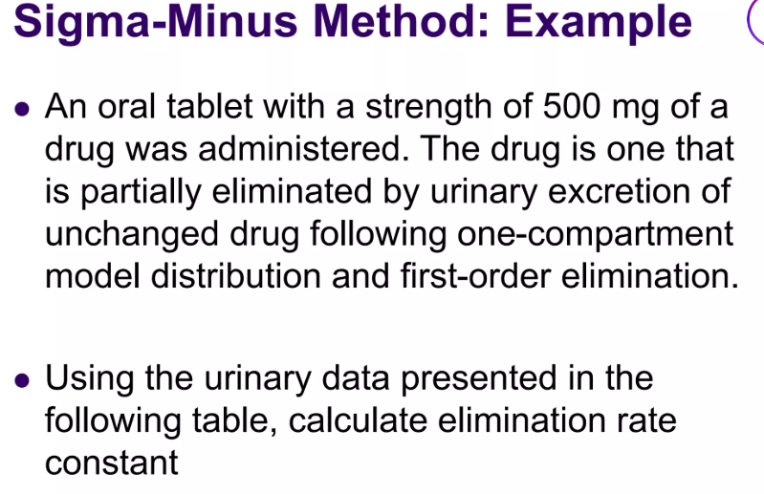

Slide 19
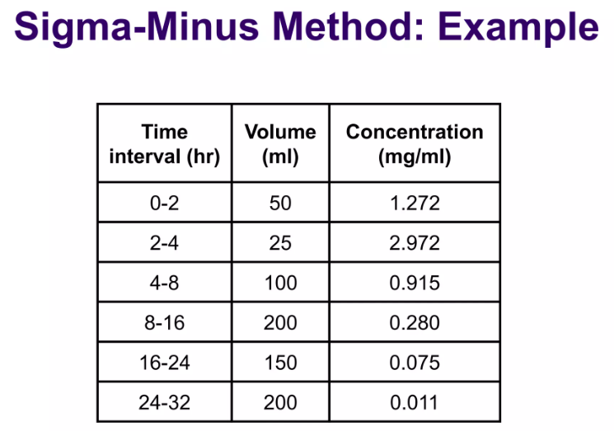

Slide 20
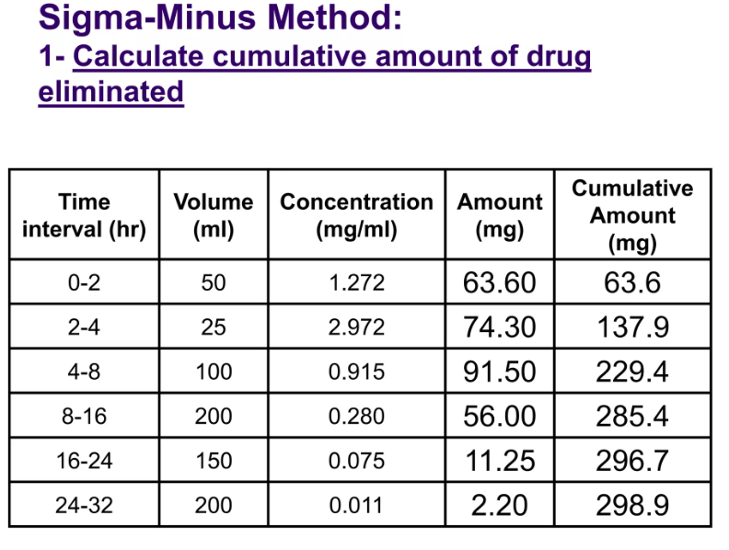

Slide 21
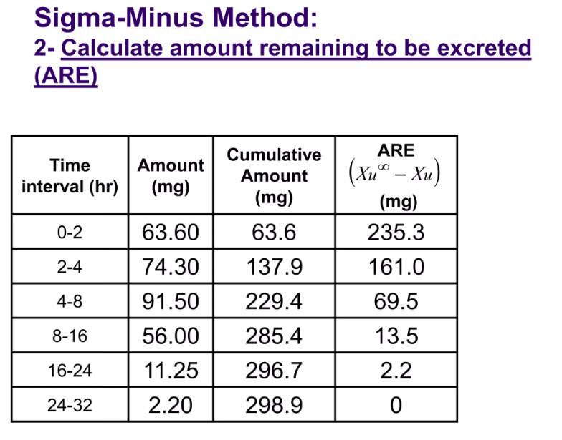

Slide 22
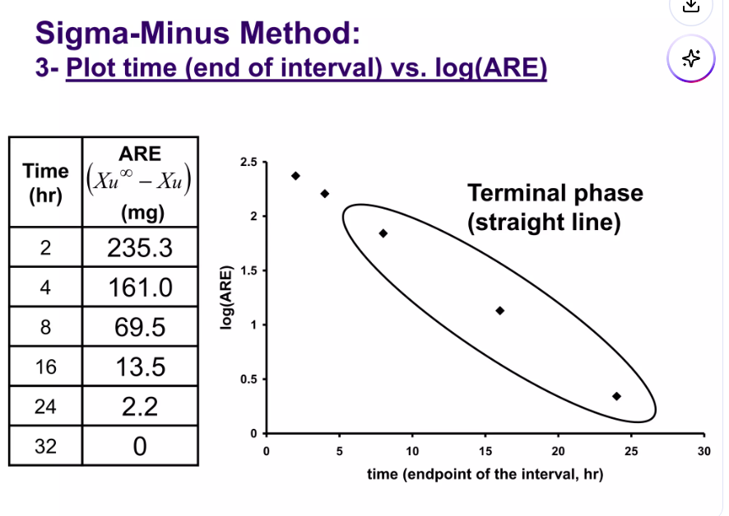

Slide 23
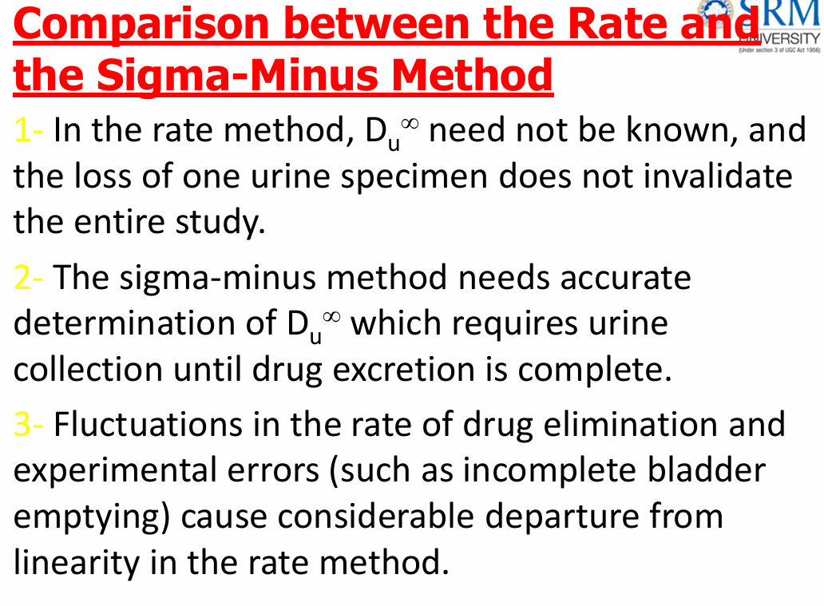

Slide 24
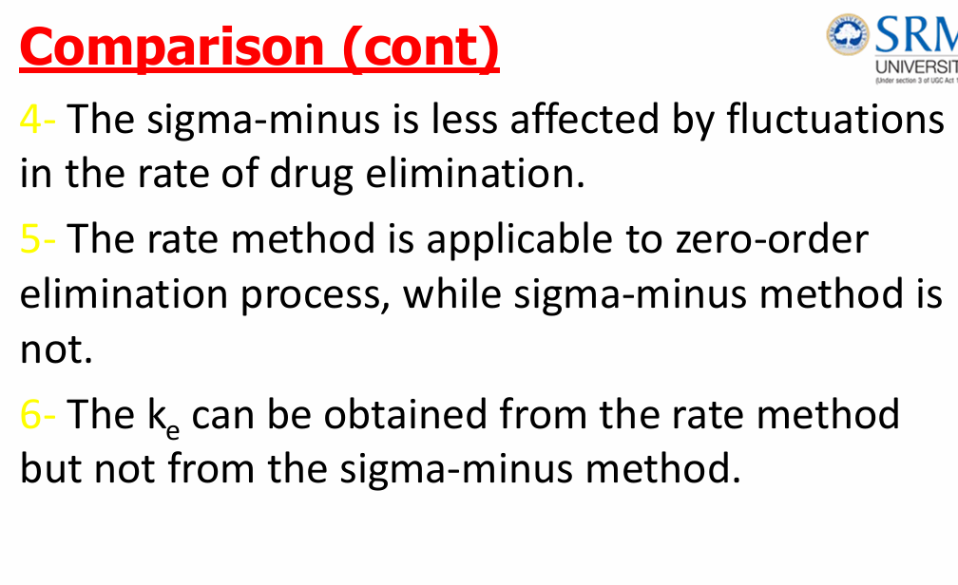

Slide 25


